Slide 1
Raising Resilient Kids
Dr. Heather Tacovsky, NCSP
Barnegat Early Childhood Advisory Council

Slide 2
Quick Intro…
NJ certified school psychologist
Assistant professor of psychology and counseling at GCU (Lakewood campus)
Doctor of Psychology in School Psychology
Research interests in executive functions and learning, literacy, and resilience
Mother of 2 boys
(6 and 3)

Slide 3
Agenda
Opening Thoughts/Questions
Mental Health trends
Resilience and Self-Regulation
What can parents do—Focus on simple, general skills and support
Q&A (feel free to ask questions anytime!)

Slide 4
Opening Thoughts
What do you know about children’s mental health?
Includes social, emotional, behavioral aspects
*GOOD mental health does not mean the absence of disorder…it means possessing the skills to cope with life’s changes and emotions
We want all of our children to be mentally healthy and be prepared to maintain mental wellness through childhood and beyond
What is resilience?
Our ability to recover from difficulties; our ability to cope in a positive way

Slide 5
What trends are we seeing today…?
Stigma persists regarding mental health
DESPITE it being PART OF THE HUMAN EXPERIENCE
Misinformation…less help-seeking
Less time outside
More time with screens
Less time interacting/connecting
More time drilling/instructing
Less time PLAYING/unstructured
How can children develop the skills they need to cope with life? …with change or the unknown?

Slide 6
Positive Adjustment and Resilience
Coping and Emotional Regulation
KEY to resilience
Children understand more than they can express…
Coping is defined as “constantly changing cognitive and behavioral efforts to manage specific external and/or internal demands that are appraised as taxing or exceeding the resources of the person” –Lazarus & Folkman
“how people mobilize, guide, manage, energize, and direct behavior, emotion, and orientation or how they fail to do so” –Skinner and Wellborn
Dynamic process that changes with the demands of the stressor and includes a purposeful response—REGULATION of stress responses
Sometimes simple things can be STRESSORS to children

Slide 7
Promote Positivity and Growth
Help foster a GROWTH MINDSET
“I can’t do this” vs. “How can I figure out how to do this?”
Positivity and Optimism
Model this with your own reactions and behaviors
Predictable routines/rituals
Clear expectations and rules
Foster Competence/Achievement/Success
Promote Physical health
Nutrition, sleep, etc.
Normalize BIG feelings → support emotional regulation
Acknowledge, relate, support, guide problem solving

Slide 8
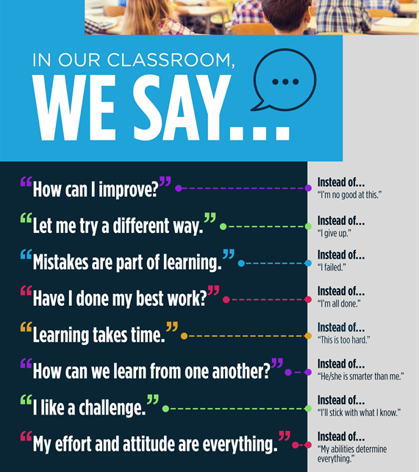
Growth Mindset phrases
At school and at home

Slide 9
More on Emotional Regulation
What is it?
Managing emotions and behavior related to a certain situation
Reacting/responding, calming down, problem solving
Handling stressors without a tantrum
How can we foster this?
Strengths-based approach
Play games or activities that encourage turn taking, listening, watching, sharing, etc.
Examples: freeze dance—fast music = fast dancing; slow music = slow dancing (reverse cues!) Connect behavior to real life. *inhibition, gross motor, listening
Bubbles—let them pop, then tell them no popping—explain self-control and connect (waiting your turn or not eating all of the candy)
https://www.facebook.com/growtherapy/videos/2294670124145356/
AGAIN…FEELINGS are OK, it’s how we manage our feelings!

Slide 10
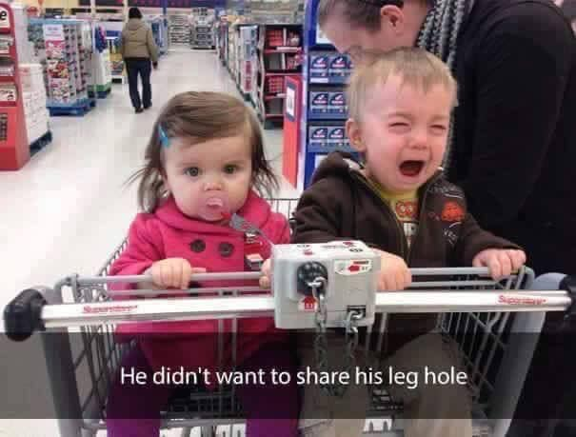
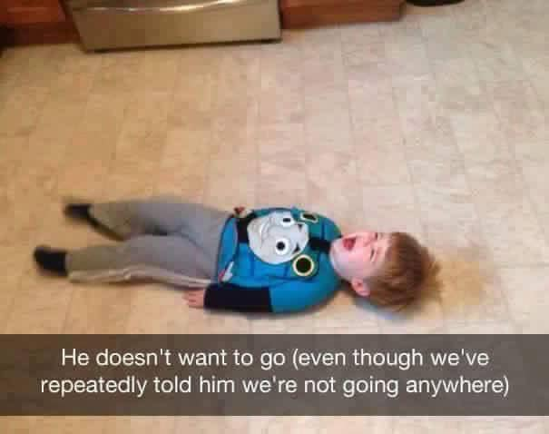
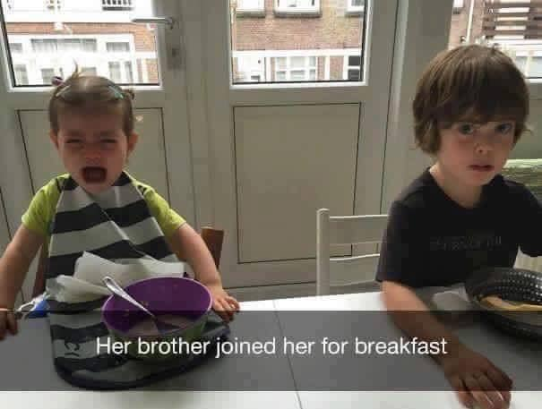
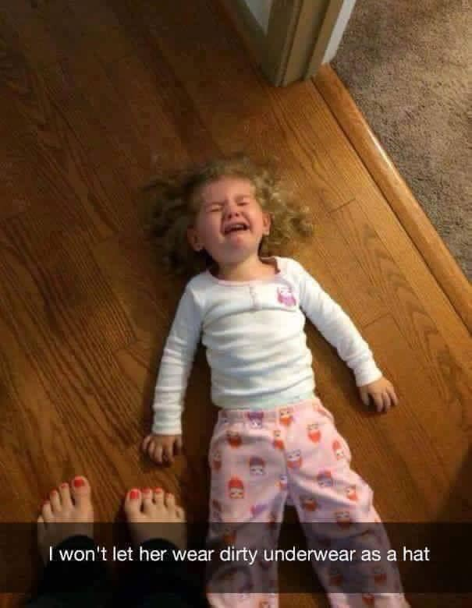

Slide 11
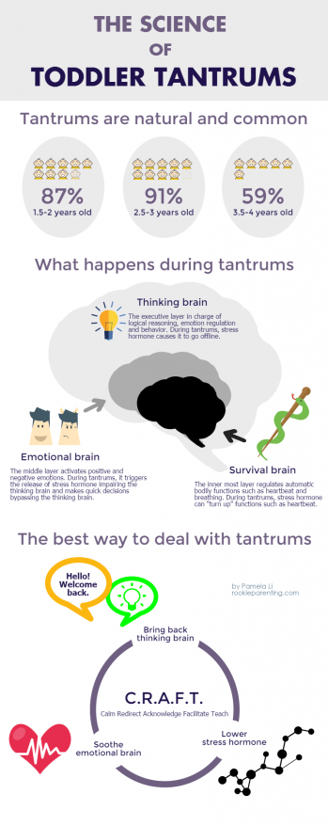
WHY? And more importantly, what to do
When we understand why, we can be more patient and understanding
Consider age, changes in routine, tired, hungry, attention?
Brain basis for tantrums; biological influences
Less talking during a tantrum and more calming, soothing (unable to process logic)
DON’T give in to the demand
Do they need a break? Removal from situation?
Do they need help soothing themselves to a more regulated state?
Let the tantrum run its course (unless child is at risk of injuring self or someone else)
Sometimes it is best to open up space to allow the feelings, even the big and ugly ones!!
Once the child is calm, a quick chat about what you think they were thinking or feeling before the tantrum can help. You can then offer a strategy/wording for them to try next time.
“It looked like you got frustrated when I told you that you could not run with your scissors. Scissors are only for cutting paper when we are seated together. Do you think that you can put the scissors down the next time you are cutting paper and want to walk or run around? That would be much safer and we would all feel better.”

Slide 12
Preventing tantrums
*Remember, what works for some, will be different for others!!
Warnings/prep time for transitions
Visual supports/reminders
Consistency in routines and expectations
Consistency in consequences for undesirable behaviors
We can also better facilitate problem solving
Modeling
Explicit teaching with words or pictures
VALIDATE feelings “I could see that you were very angry”
Use calm words and a calm voice (gosh, I know this can be hard!!...remember deep breaths ☺)

Slide 13
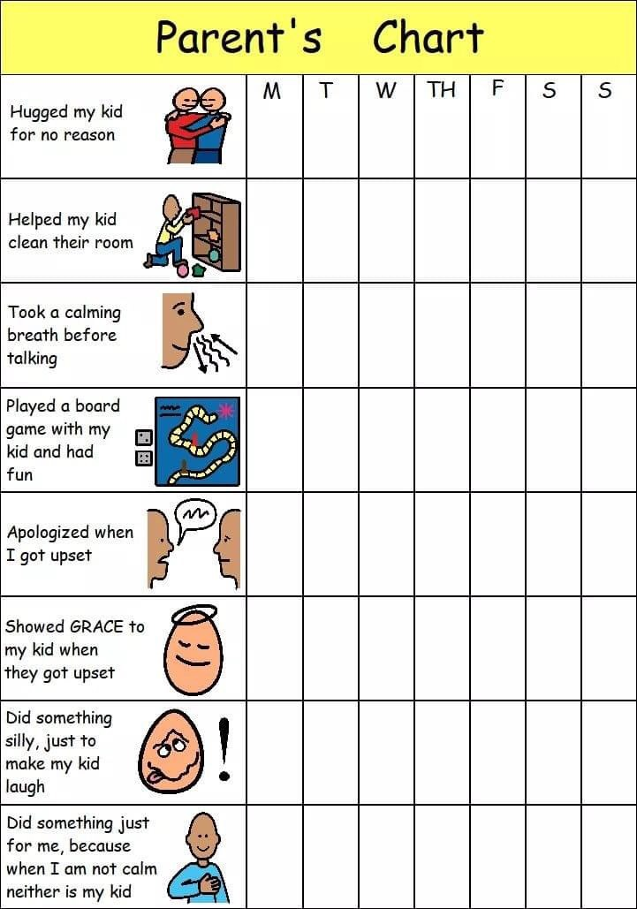
What else can we do?
Be kind to yourself
Be patient with yourself
Forgive yourself
Be honest about your feelings (modeling!)
PLAY outside everyday
Keep them busy with activities that promote a sense of accomplishment
Child-directed (yet supervised) play
Encourage and maintain social connections
*Chart from Affinity Consulting Ontario

Slide 14
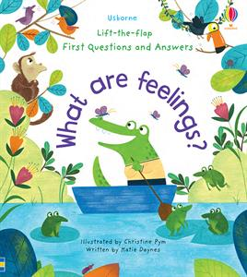
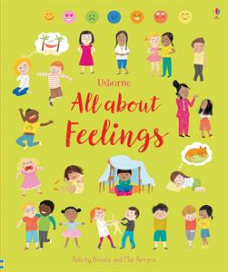
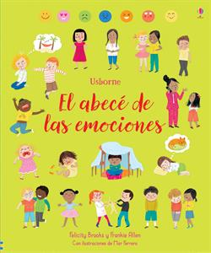
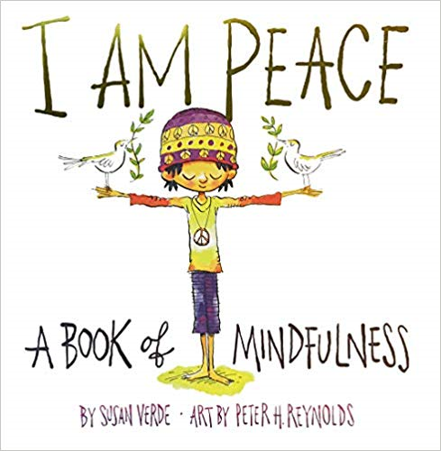
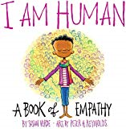
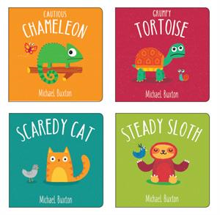
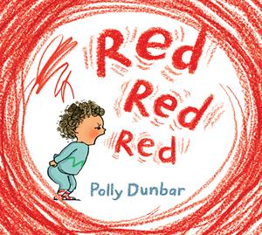
Book Recommendations for families
I am Love: A book of compassion Susan Verde
I am Peace: A book of mindfulness Susan Verde
I am Human: A book of compassion Susan Verde
All About Feelings Felicity Brooks (also in Spanish)
All About Families Felicity Brooks
Lift the Flap First Q&A: What are Feelings? Katie Daynes
What if I know my Feelings? Michelle Nelson Schmidt
Jonathon James and the Whatif Monster Michelle Nelson Schmidt (also in Spanish
First Time Feelings Collection: Cautious Chameleon; Grumpy Tortoise; Scaredy Cat; Steady Sloth M. Buxton
Best Behavior Patricia Hegarty
Red Red Red Polly Dunbar
I Breathe Susie Brooks
Mindful Kids cards Barefoot Books

Slide 15
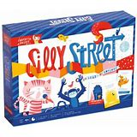
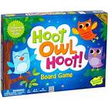
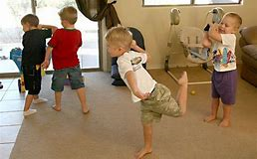
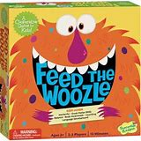
Game/Activity Recommendations
Silly Street
Sneaky, Snacky Squirrel
Sunny and Stormy Day: Book and Game
Cooperative Games such as:
Jenga
Feed the Wozzle
Race to the Treasure
Count Your Chickens
Hoot, Owl, Hoot
Red Light, Green Light
Simon Says
Yoga Poses

Slide 16
Other resources
Tinkergarten.com (for outdoor activities)
Many can be adapted for indoor play
Activities are appropriate for ALL types of weather
https://sleepingshouldbeeasy.com/
NASPonline.org/resources (mental health and school based resources
Childmind.org
https://positivepsychology.com/mindfulness-for-children-kids-activities/
Audible (if your children enjoy being read to but you’re in need of a break for work or for yourself)
Other community agencies:
Library programs, Dept of Human Services, Oasis Family Success Center, Barnegat Communities that Care

Slide 17
Key Points
Mental health issues are on the rise in children
Impact of stigma
Mental health is just as important as medical/physical health
Resilience –Coping skills
Self-care for the caregiver
Seek support/network to share ideas and/or just to vent!
Decrease screen usage; Increase connection through reading or play
Deep breaths, patience, grace (we are human, too!)
Increase outside time AND free play
Increases creativity and problem solving
Foster coping, resilience, and self-regulation!

Slide 18
Final Q&A
Questions, comments, or tips to share?
THANK YOU!!!
My contact info: Dr. Heather Tacovsky, NCSP
htacovsky@Georgian.edu
heather.tacovsky@gmail.com

